Slide 1
Microsoft & Containers
Speaker Name

Slide 2
Containers Overview

Slide 3
Containers A new approach to build, ship, deploy, and instantiate applications
Applications traditionally built and deployed onto physical systems with 1:1 relationship
New applications often required new physical systems for isolation of resources
Package and run apps within
containers
Physical
Physical/virtual
Higher consolidation ratios and better utilization
Faster app deployment than in a traditional, physical environment
Apps deployed into VMs with high compatibility success
Apps benefited from key VM features i.e., live migration, HA
Key benefits
Further accelerate app deployment
Streamline development and testing
Reduces the “it works on my machine” problem
Lower costs associated with app deployment
Increase server consolidation
Virtual

Slide 4
Server Virtualisation: Each app and each version of an app has dedicated OS
Containers: All containers share host OS kernel and appropriate bins/libraries
App A (v1)
App A (v1.1)
App B (v1.7)
Bins/Libs
Bins/Libs
Bins/Libs
App A (v1)
App A (v1.1)
App B (v1.7)
App B (v1.7)
App B (v1.7)
App B (v1.8)
App B (v1.8)
App B (v1.9)
Guest OS
Guest OS
Guest OS
Bins/Libs
Bins/Libs
Hypervisor
Docker Engine
Host OS
Host OS with container support
Server (usually physical)
Server (physical or virtual)

Slide 5
Where do containers fit?
Virtual Machines
Virtual Machine Scale Sets
Containers
Azure App Services
Azure Functions
IaaS
Infrastructure Overhead
PaaS
Cloud vendor specific
Notes:
Not comprehensive. Higher level of abstraction from infrastructure the lower overhead and exposure to the server OS

Slide 6
Monolithic Applications
Microservices
Service 1
Component 1
Service 2
Component 2
Component 3
Service 3
Scaled Monolith
Scaled Microservices
Server 1
Server 2
Server 3
Service 1
Service 2
Component 1
Component 1
Component 1
Component 2
Component 2
Component 2
Service 2
Component 3
Component 3
Component 3
Service 3
Service 2
Service 3
Notes:
Scale more efficiently
Easy to understand
Different technologies
Faster to deploy

Slide 7
Windows Server Containers

Slide 8
The story so far…
Roles and features
GUI shell
Full server
Minimal server interface
Windows/ Windows NT
Server Core
Server Core
Windows NT to Windows Server 2003
Windows Server 2008 and Windows Server 2008 R2
Windows Server 2012 and Windows Server 2012 R2

Slide 9
The next step in the journey…
Nano Server: A new headless, 64-bit only, deployment option for Windows Server
Server with a desktop experience
Deep refactoring with cloud emphasis
Cloud fabric & infrastructure (clustering, storage, networking)
Born-in-the-cloud applications (PaaS v2, ASP.NET v5)
VMs & Containers (Hyper-V & Docker)
Server Core
Extend the Server Core pattern
Roles & features live outside of Nano Server
No binaries or metadata in OS image
Standalone packages install like apps
Full driver support
Antimalware
Nano Server

Slide 10
Deployment improvements
Setup time (Sec)
Disk footprint (GB)
VHD size (GB)

Slide 11

Windows Server Container OS environments
Nano Server
Server Core
Highly optimized
Highly compatible
“Born in the cloud” applications
Traditional applications

Slide 12
Docker integration
Docker
An open source engine that automates the deployment of any application as a portable, self-sufficient container that can run almost anywhere
Partnership
Enable the Docker client to manage multi-container applications using both Linux and Windows containers, regardless of the hosting environment or cloud provider
Docker Hub
Huge collection of open and curated applications available for download. https://hub.docker.com
Collaboration
Bring Windows Server containers to the Docker ecosystem to expand the reach of both developer communities
Docker Engine
Docker Engine for Windows Server containers is developed under the Docker open source project
Docker Client
Windows customers can use the same standard Docker client and interface on multiple development environments
Docker Client
Docker.exe
Examples:
docker run
docker images
Linux
Docker Remote API
Examples:
GET images/json
POST containers/create
Docker Engine
(Daemon)
Docker Engine
(Daemon)
Windows Server
Container Support
Linux Container
Support (LXC)

Slide 13
PowerShell For Docker
Docker Client
Docker Client
PowerShell
Docker Compose
Docker Compose
Docker Registry
Docker Registry
Docker Swarm
Docker Swarm
Open source project:
https://github.com/Microsoft/Docker-PowerShell/
Executes commands against the Docker Engine API as specified by the (DOCKER_HOST) environment variable
Example:
Get-Container | Stop-Container
Docker Engine
Docker Engine
Operating System
Operating System

Slide 14
Windows Server Containers
Notes:
See demos in https://github.com/MSFTImagine/computerscience/tree/master/Tech%20Talks/ContainerDemo
docker images
Create custom image using docker build
Push to docker hub
Search on docker hub
$env:DOCKER_HOST="tcp://192.168.88.169:2375"
docker info

Slide 15
Hyper-V Containers
Notes:
Can be security concerns with containers
Hostile multi tenancy environments and regulated workloads
What is a Hyper-V Container?
Small stateless utility VM including dedicated kernel
Kernel level isolation between each Hyper-V container and the container host
Uses a cloned utility VM with saved state to eliminate start-up time

Slide 16

Hyper-V Containers
Windows Server container(s)
Hyper-V container(s)
Host Operating System
Virtual machine(s)
Hyper-V Hypervisor

Slide 17
Hyper-V Containers using nested virtualization
Windows Server container(s)
Hyper-V container(s)
Hyper-V Hypervisor
Host Operating System
Virtual machine(s)
Hyper-V Hypervisor

Slide 18
Creating Hyper-V Containers:
Install-NanoServerPackage Microsoft-NanoServer-Compute-Package
docker run -d --isolation=hyperv nanoserver cmd
Host Operating System | Windows Server container | Hyper-V container
Windows Server 2016 Full UI | Server Core image | Nano Server image
Windows Server 2016 Core | Server Core image | Nano Server image
Windows Server 2016 Nano | Nano Server image | Nano Server image
Windows 10 | Not Available | Nano Server image
Hyper-V is the default and only option on Windows 10

Slide 19
Docker for Windows

Slide 20
Docker for Windows
Windows 10
Parent OS
Linux VM: MobyLinuxVM
App A (v1.1)
App B (v1.7)
App B (v1.8)
App B (v1.9)
App C (v5.2)
App C (v5.3)
Docker CLI
Docker Engine
Hyper-V
Notes:
It is NOT Windows Server containers
Enables development using Docker on Windows OS
Creates a Hyper-V VM, “MobyVM” running the Docker daemon enabling Linux containers
Docker CLI can be used on the Windows machine to work with Docker engine running elsewhere

Slide 21
Docker for Windows (with Nanoserver)
Windows 10
Parent OS
Linux VM: MobyVM
Nanoserver VM
App A (v1.1)
App B (v1.7)
App G (v2.1)
App H (v1.3)
App B (v1.9)
App C (v5.2)
App H (v1.4)
App I (v7.3)
Docker CLI
Docker Engine
Docker Engine
Hyper-V
Notes:
How I work. Change DOCKER_HOST to communicate with the required Docker engine.

Slide 22
Docker for Windows
Notes:
See https://github.com/MSFTImagine/computerscience/tree/master/Tech%20Talks/ContainerDemo
Run through settings
Show vms
Kitematic

Slide 23
Azure and Containers

Slide 24
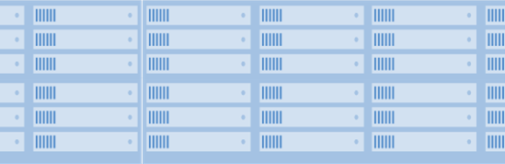
Microsoft Azure & Azure Stack
Platform Services
Platform Services
Developers
Security and Management
Hybrid
Operations
Security and Management
Hybrid
Operations
Cloud-inspired Infrastructure
Powered by Windows Server, Hyper-V, System Center, and Azure
One Azure ecosystem
Infrastructure Services
Unified app development
Compute
Storage
Network
Azure services in your datacenter
Compute
Storage
Network
Your Datacenter Infrastructure
Azure Global Datacenters
Operations
Microsoft Azure Stack
and Cloud Platform System
Microsoft Azure Cloud
Public, Global, Shared
Notes:
Public Cloud, Private Cloud, On-Premises – it’s not either-or and the world is never just black or white
It’s your choice and Microsoft offers a hybrid cloud solution that is tailor-made for your organization and your applications
Microsoft Azure Stack is a new hybrid cloud platform product that enables your organization to deliver Azure services from your own datacenter to help you achieve more
Get the power of cloud services, yet maintain control of your datacenter for true hybrid cloud agility
You decide where to keep your data and applications - in your own datacenter or with a hosting service provider
Easily access public cloud resources to scale at busy times of the year, for dev-test, or whenever you need them
Only Microsoft builds and runs its own hyper-scale datacenters and delivers that proven innovation to your datacenter

Slide 25





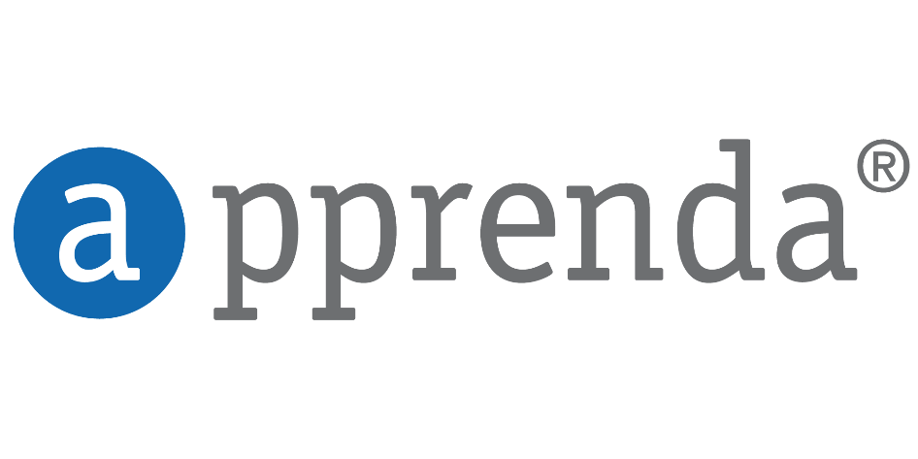



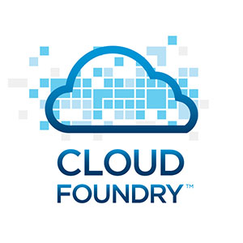



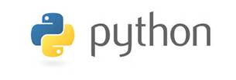





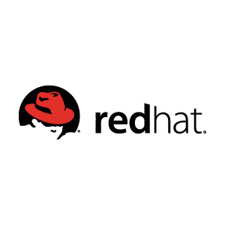
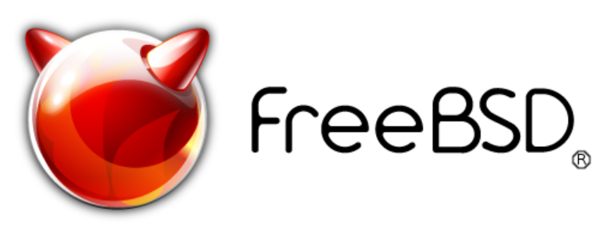


Open cloud
Management
Applications
Open & flexible
Hyper-scale
App Frameworks
Proven
Databases & Middleware
Hybrid
Infrastructure
Linux
Notes:
Azure is open and flexible – you bring what you know and simply continue to use it – there are no second class citizens in the Microsoft cloud
Whether it’s platforms, languages, tools or apps – we support an ever-growing set of OSS and proprietary technologies, tools and standards
With Azure, you have choices - choices that help you maximize your existing investments
You bring the tools you love and skills you already have, and run virtually any application, using your data sources, with your operating system, on your devices
Or - complement what you’ve already built by using Azure to add additional value to your app
Augment your iOS or Android mobile application with identity and access management through Azure Active Directory, or cloud-powered insights through Azure Data Lake Analytics
Run Linux batch processes to support your .NET applications
And tap a growing ecosystem of open source solutions available from Azure Marketplace that enable rapid deployment in the cloud
At Microsoft, open source is a part of our day-to-day approach to cloud innovation
We are also constantly looking for ways to improve developer and user experiences with SDKs for open source languages and an open API
Plus, we are committed to sharing our cloud learnings with you and for your datacenters, thanks to Linux and open source support in Azure Resource Manager and Azure Stack

Slide 26
Proof that Microsoft is doing Open Source!
https://octoverse.github.com/

Slide 27
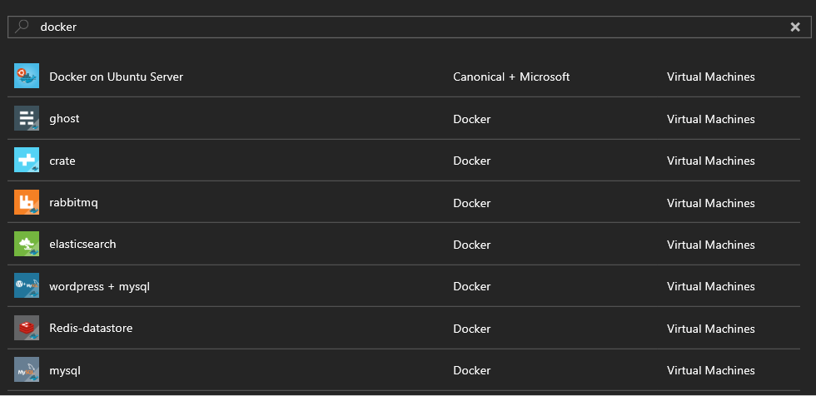
Marketplace VMs using Docker
Notes:
Preconfigured VMs with Docker installed and a container launched on startup.

Slide 28
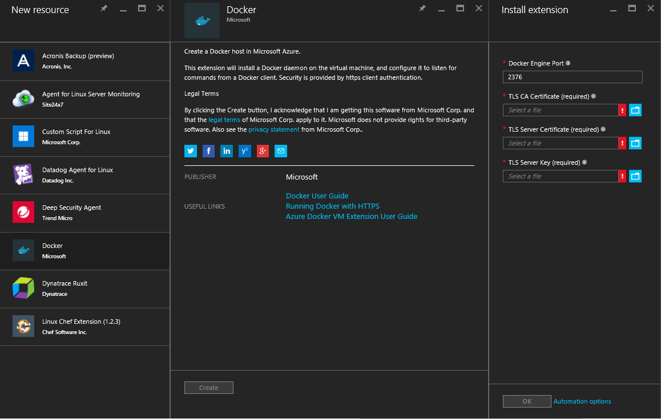
Docker VM Extension
https://github.com/Azure/azure-docker-extension
Install Docker on a Linux VM using Portal, PowerShell or ARM Template
Notes:
Installs and configures Docker on VM start-up.

Slide 29
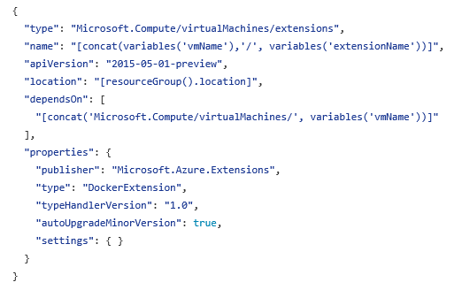
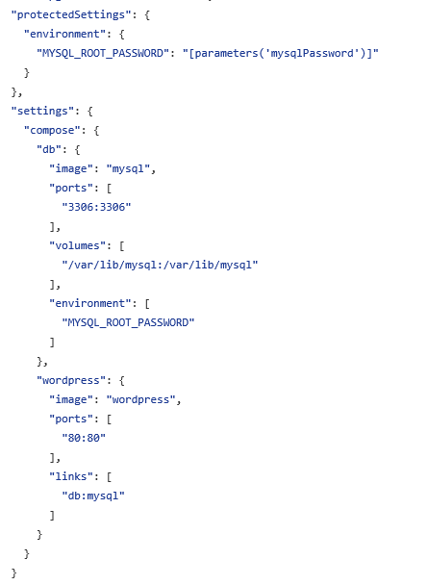
Docker VM Extension in ARM Template
Deploy services by providing docker-compose file in JSON format
Notes:
ARM templates enable infrastructure as code on Azure.
Can include a Docker compose file in JSON format.

Slide 30
Azure Driver for Docker Machine
Create a Linux VM with Docker using a single command
$DockerMachineVMName = "dockerdemovm“
docker-machine create --driver azure `
--azure-subscription-id $SubscriptionID `
--azure-location 'West Europe' `
--azure-resource-group 'DevOpsDemo-DockerMachine' `
$DockerMachineVMName
https://docs.docker.com/machine/drivers/azure/

Slide 31
Azure Container Service
Containers
Container Tooling e.g. Docker CLI
Container Services (Docker Swarm or DC/OS)
Linux
Windows Server
Service Tooling e.g. ARM Template
VMs and VM Scale Sets
Azure Stack
Azure
Notes:
Swarm or DC/OS
Linux, Windows in development
Can scale up using the cli

Slide 32
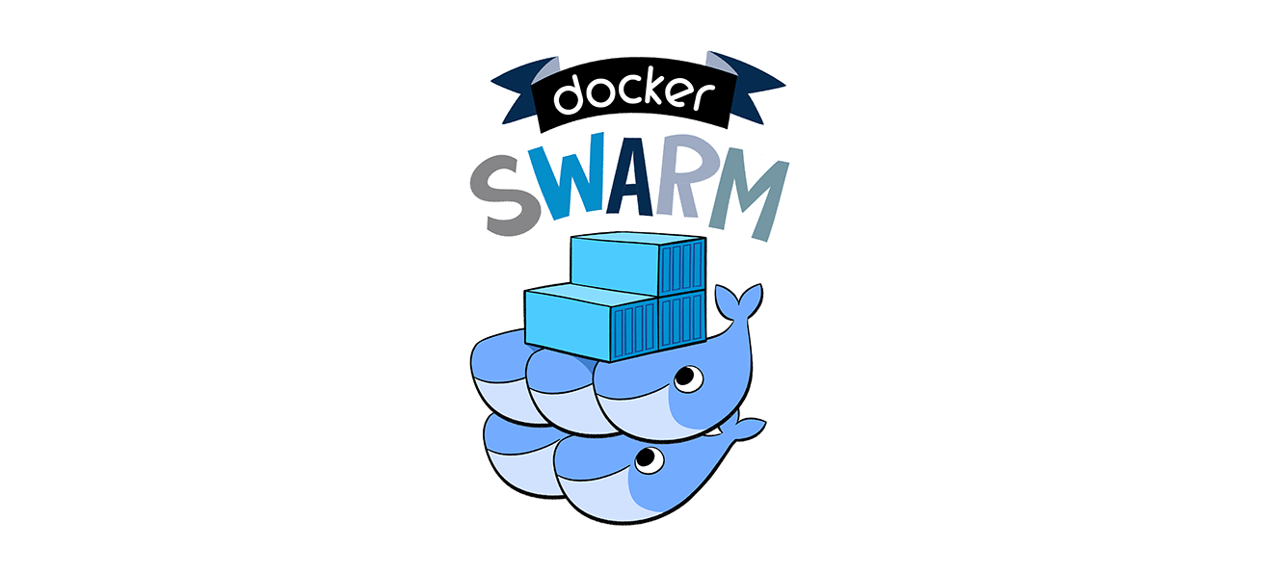
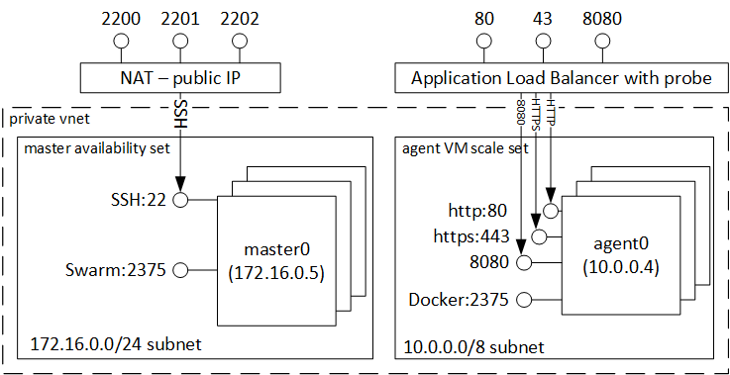
ACS with Swarm
443

Slide 33
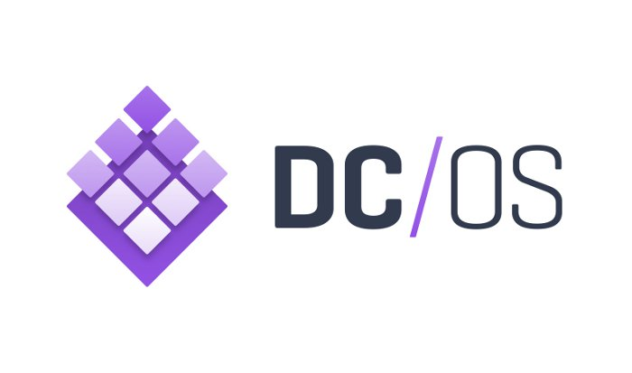
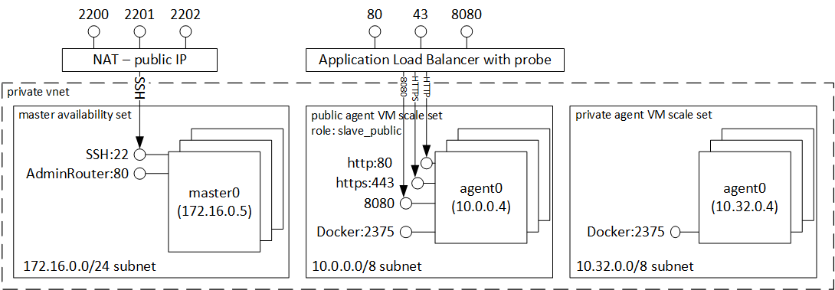
DC/OS
Notes:
What is DC/OS? Also a DC/OS solution created and maintained by mesosphere

Slide 34
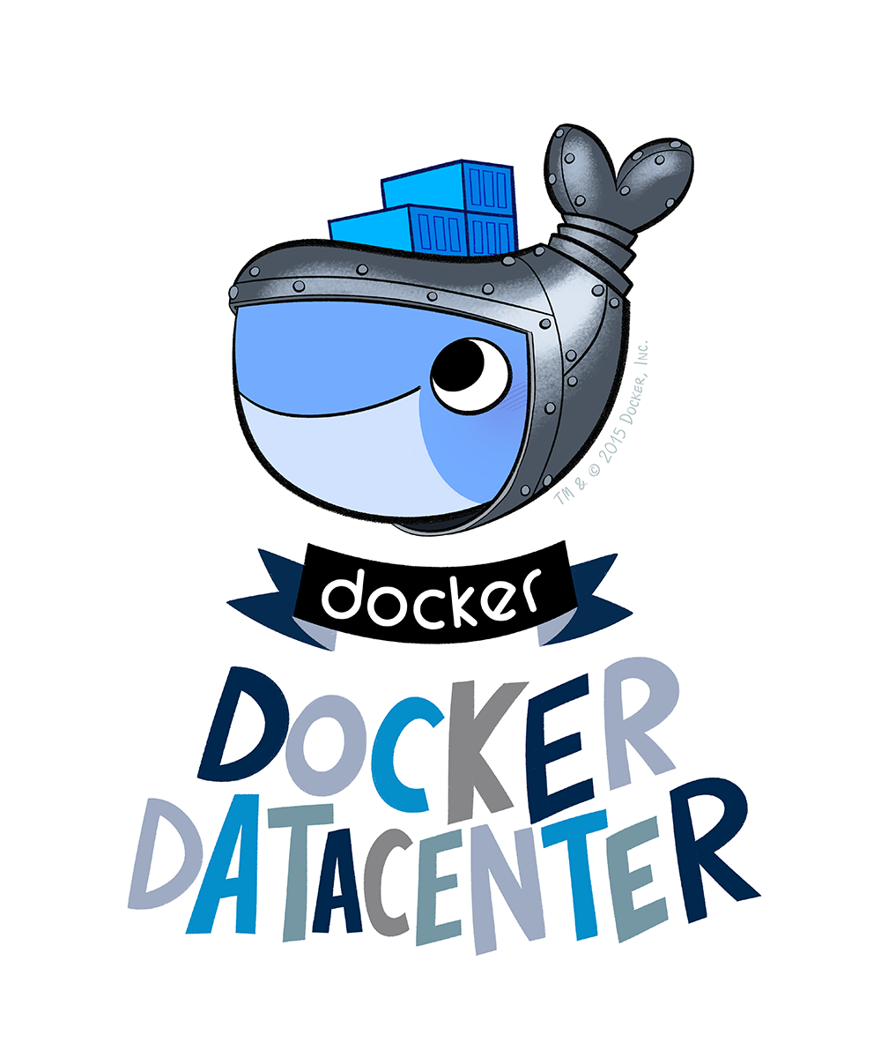
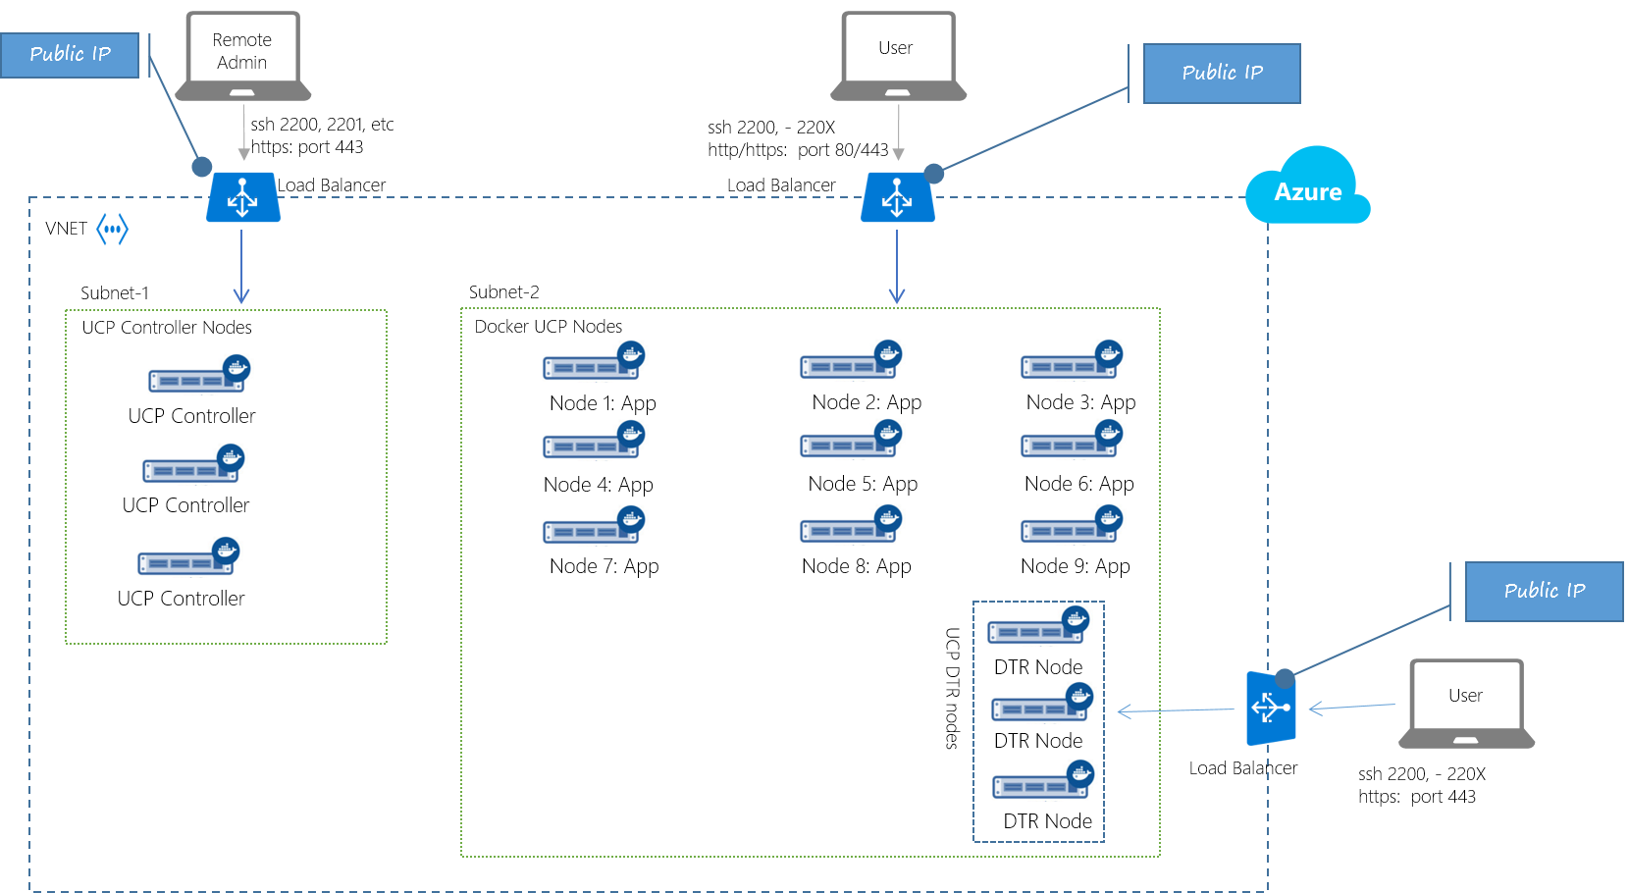
Docker Datacenter
Notes:
UCP and DTR
Created by Docker
Chargeable
Support is responsibility of Docker
Includes UCP and Trusted Registry
Need to pay for it!

Slide 35
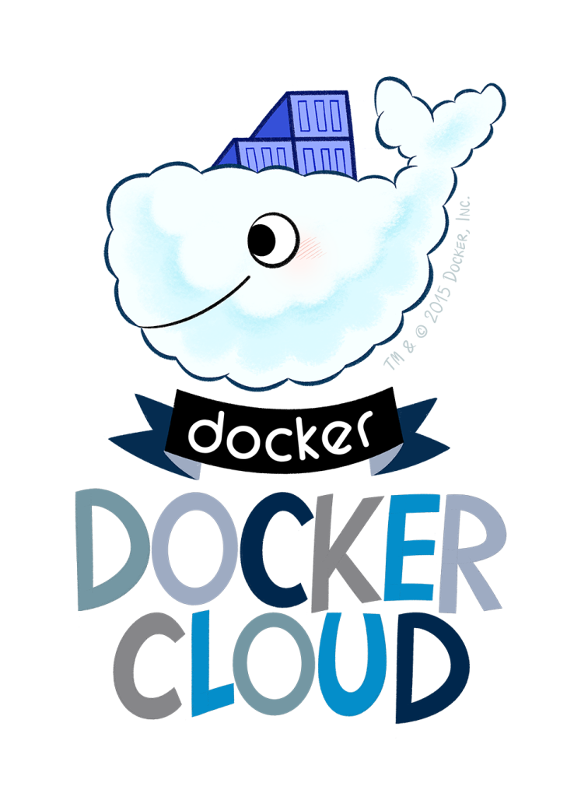
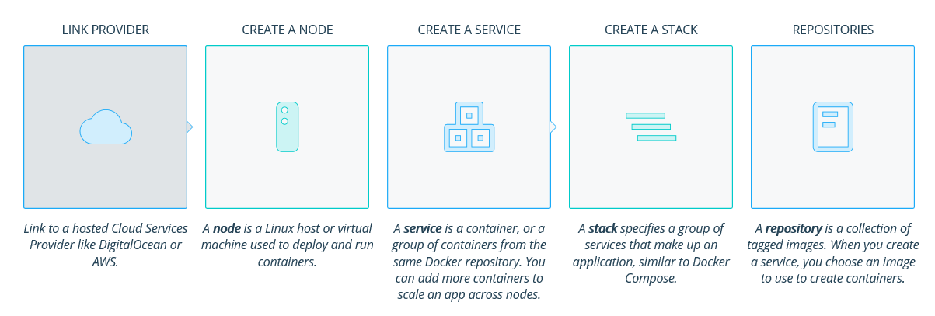
Docker Cloud
Docker hosted solution
Nodes can run anywhere
Pay per node
Notes:
Multiple platform. Orchestrated and hub form Docker.

Slide 36
Docker for Azure
Existing Docker implementations require rules adding to Azure load balancer to publish services
Docker for Azure automatically adds the appropriate rules when a container or service is published
Sign up at http://beta.docker.com

Slide 37
Docker Datacentre
Notes:
See https://github.com/MSFTImagine/computerscience/tree/master/Tech%20Talks/ContainerDemo
Show in marketplace, show deployed
Run env.ps1
Show docker info
Deploy container

Slide 38
Docker in Release Pipeline

Slide 39


DevOps process with containers
Developers update, iterate, and deploy updated containers
2
3
Operations collaborates with developers to provide app metrics and insights
Developers build and test apps in containers, using development environment
1
2
Operations automates deployment and monitors deployed apps from central repository
Central Repository
Containers pushed to central repository

Slide 40
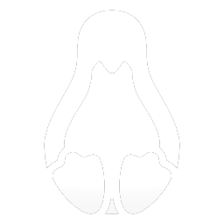



Plan & Track Work
Source Code Management
Package Management
Quality Management
Cross-platform Build
Continuous Deployment
Release Management
Feedback Management
Application Telemetry
Extend and Customize
Visual Studio Team Services
Team Foundation Server
http://www.visualstudio.com/news/release-archive-vso
Notes:
VSTS and TFS goes FAR beyond simple source code and build and are KEY building blocks to enabling Agile and numerous DevOps practices regardless of your programming language, application architecture, or infrastructure provider.
Our DevOps solution is flexible and adapts to you instead of forcing you to change the way you work or the tools you use
Our DevOps solution is open and extensible with a large ecosystem of partners building best-of-breed extensions and integrations
Features in Visual Studio Team Services get released once every three weeks and around once per quarter those features get rolled up and put into an update which goes into the on-premises Team Foundation Server. So no matter whether you prefer to do your business in the cloud, hybrid, or on-premises, Microsoft has you covered.

Slide 41


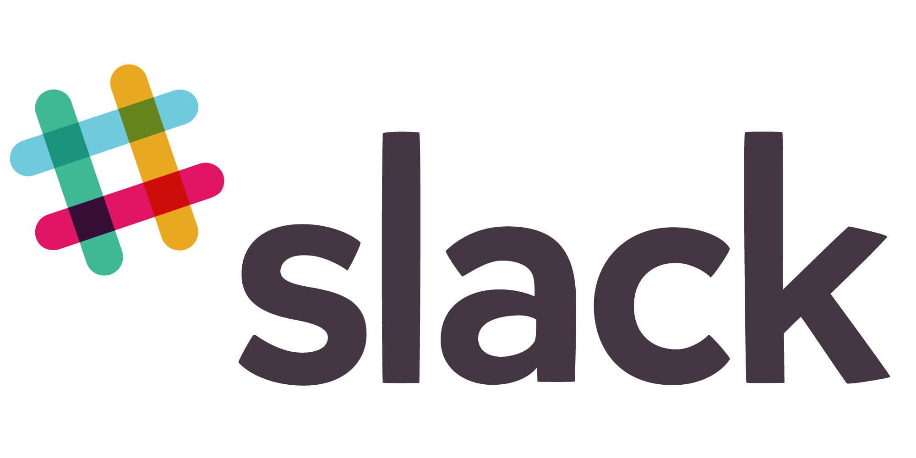
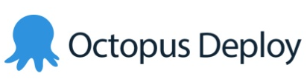











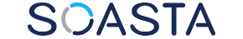















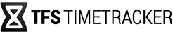



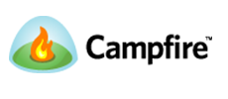

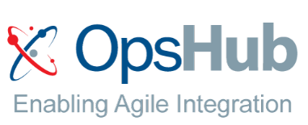

Open + Flexible Tool Chain
65
Visual Studio Code Extensions
5,910
Visual Studio Gallery Extensions
90
Visual Studio Sim-Ship Partners
48
VS Team Services Extensions
1,177 Visual Studio Code Extensions
6,538 Visual Studio Gallery Extensions
90 Visual Studio Sim-Ship Partners
171 VS Team Services Extensions
Notes:
Main point to land – VSTS/TFS is open, flexible, and integrates with your tools and if the integration isn‘t there yet you can build it in our marketplace. You can go all-in OR just pick the bits and pieces of functionality you‘d like to use.
Tasks are open source on GitHub.
Optionally choose some partners to highlight which resonate with your local audience. i.e. If you want to use GitHub for your source code and then use VSTS for builds you can do this. You can use Jenkins for builds and use VSTS for release management.

Slide 42
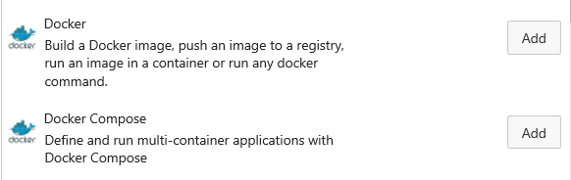
Visual Studio Team Services
Docker and Docker Compose tasks available for build and release:
Build an image
Push an image
Run an image
Generic Docker command
Deploy a compose-file
Commit to source control
Build image from dockerfile
Deploy using Compose
Push to Hub or Trusted Registry

Slide 43
VSTS Build & Release to Docker Datacenter
Notes:
See demo https://github.com/MSFTImagine/computerscience/tree/master/Tech%20Talks/ContainerDemo
Commit
Ci to docker build
Store in registry
deploy

Slide 44
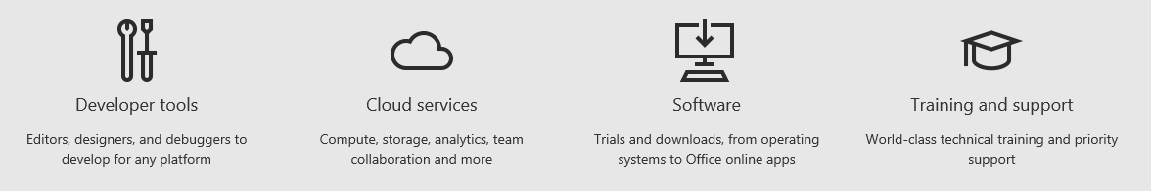
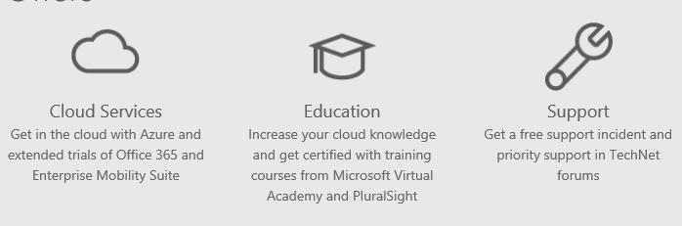
Want to try this out?
Visual Studio Dev Essentials: https://developer.microsoft.com
IT Pro Cloud Essentials: https://www.itprocloudessentials.com

Slide 45
Technical resources:
DevOps Fundamentals: https://channel9.msdn.com/Series/DevOps-Fundamentals
DevOps Dimensions: https://channel9.msdn.com/Shows/DevOps-Dimension
The Container Channel https://channel9.msdn.com/Blogs/containers
Get access to free online training: https://mva.microsoft.com/training-topics/devops
Slides and demos: https://github.com/MSFTImagine/computerscience/tree/master/Tech%20Talks
Questions?
Notes:
Containers are coming to Windows
Docker support enables us to work with both Linux and Windows containers using same command set
Azure is an open platform – bring the technologies you choose
VSTS enables DevOps practices and integrates with many technologies

Slide 46
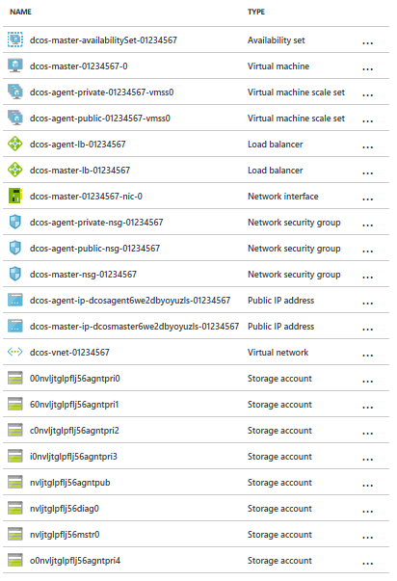

Slide 47
Not needed

Slide 48
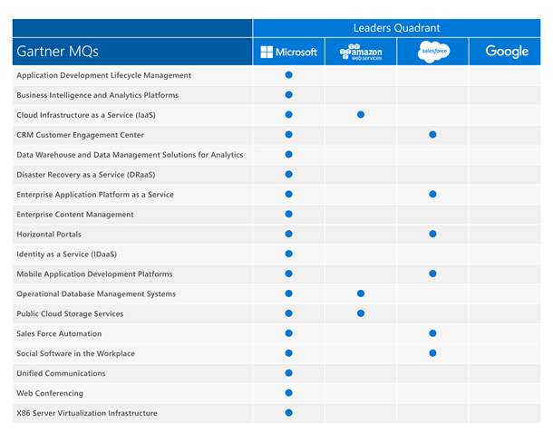

Slide 49
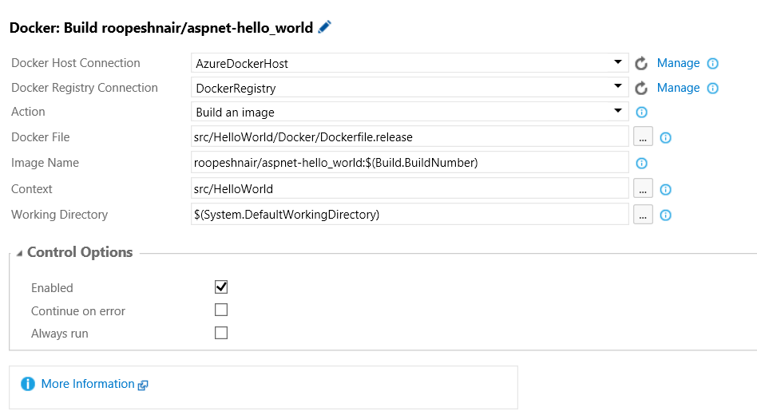
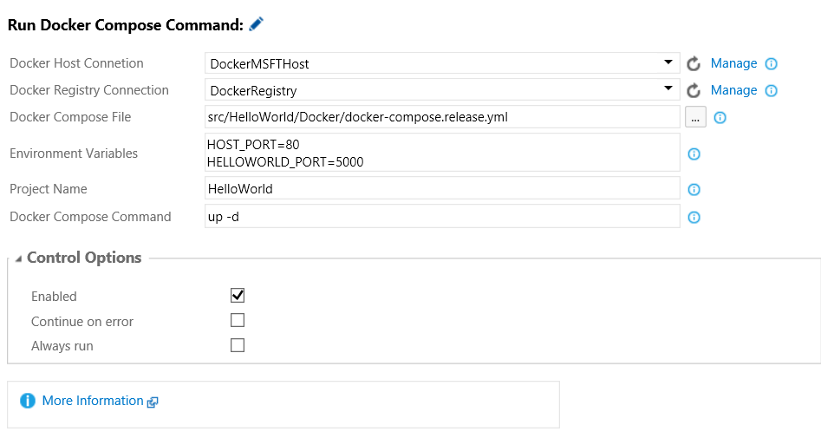
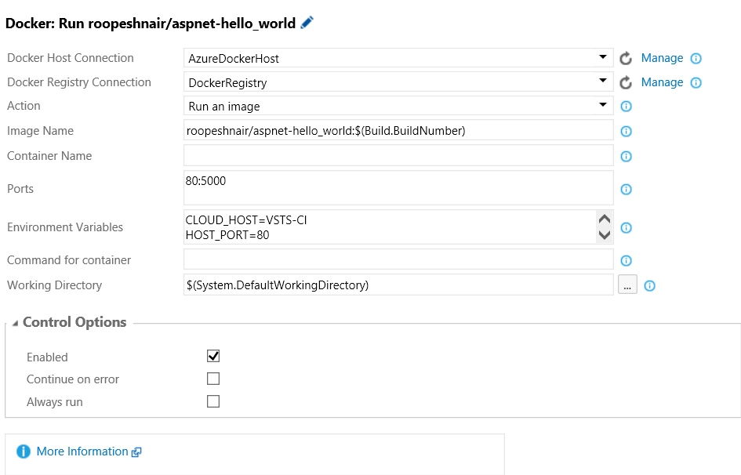
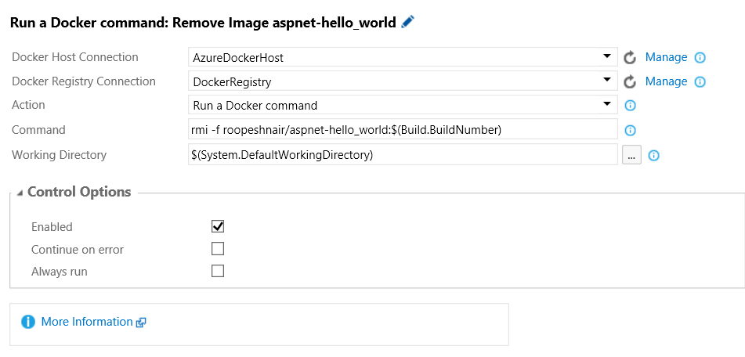

Slide 50
Introduction to Containers

Slide 51
Traditionally one OS per server
Operating System
OS Image
Physical host
Notes:
Applications traditionally built and deployed onto physical systems with 1:1 relationship
New applications often required new physical systems for isolation of resources

Slide 52
Virtualisation
Host Operating System
Operating
System
Operating
System
OS Images
Virtual machine(s)
Hardware Virtualization
Notes:
Multiple os per server
Higher consolidation ratios and better utilization
Faster app deployment than in a traditional, physical environment
Apps deployed into VMs with high compatibility success
Apps benefited from key VM features i.e., live migration, HA
Server sprawl, more servers to manage,

Slide 53
Containers
Containers
Host Operating System
Notes:
Further accelerate of app deployment
Reduce effort to deploy apps
Streamline development and testing
Lower costs associated with app deployment
Increase server consolidation
Fast startupo

Slide 54
Containers can also run within a VM
Containers
Guest Operating System
OS Image
Host Operating System
Virtual machine(s)
Hardware Virtualization

Slide 55
App A
App A’
App B
Containers are isolated, but share OS and, where appropriate, bins/libraries
Bins/Libs
Bins/Libs
Bins/Libs
Guest OS
Guest OS
Guest OS
App A
App A’
App B
App B’
App B
App B’
App B
App B’
Bins/Libs
Bins/Libs
Hypervisor
Docker Engine
Host OS
Host OS
Server
Server

Slide 56
Developers
Enable ‘write-once, run-anywhere’ apps
Use existing development methodologies
Can be deployed as multi-tier distributed apps
Containers offers powerful abstraction for microservices
Enables DevOps
Operations focus on standardized infrastructure
Developers focus on building, deploying, and testing apps
Operations
Provide standardized environments for development, QA, and production teams
Abstract differences in underlying infrastructure
Higher utilization and compute density
Rapid scale-up and scale-down in response to changing business needs

Slide 57

Container ecosystem
Container runtime
Container images
Image repository
Application
Linux
Application framework

Slide 58



Development process using containers
Central Repository
Local Repository
Central Repository
Application
Framework
Application Framework
Application
Framework

Slide 59
Development process using containers
Central Repository
Local Repository
Central Repository
Application
Framework
Application Framework
Developers can choose desired application frameworks and pull them locally from central repositories
Application Framework
Application
Framework

Slide 60
Development process using containers
Central Repository
Local Repository
Central Repository
Application
Framework
Application Framework
Developers can choose desired application frameworks and pull them locally from central repositories
Application Framework
Application
Framework
Required dependencies are automatically identified and pulled locally

Slide 61
Development process using containers
using System;
class Program
{
static void Main()
{
}
}
Developers use the same programming languages and environments they are accustomed to
Central Repository
Local Repository
Central Repository
Application
Framework
Application Framework
Application Framework
Application
Framework

Slide 62
Development process using containers
using System;
class Program
{
static void Main()
{
}
}
Central Repository
Local Repository
Central Repository
Application
Framework
Application Framework
Application Framework
Application
Framework
Applications are compiled and assembled in the same way developers are accustomed to

Slide 63
Development process using containers
using System;
class Program
{
static void Main()
{
}
}
Central Repository
Local Repository
Central Repository
Application
Framework
Application Framework
A new container image is built containing the application, written by the developer
Application Framework
Application
Framework

Slide 64
Development process using containers
using System;
class Program
{
static void Main()
{
}
}
Central Repository
Local Repository
Central Repository
The new application container image can now be pushed to a central repository
Application
Framework
Application Framework
Application Framework
Application
Framework

Slide 65
Development process using containers
Central Repository
Central Repository
Application
Framework
Application Framework
Application
Framework

Slide 66
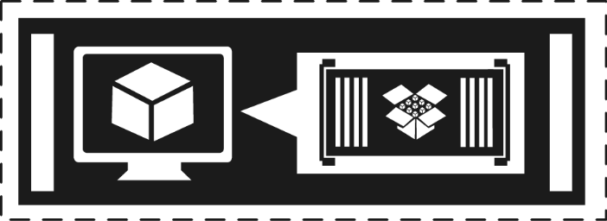
Development process using containers
Used for unit testing
Share with other developers
Central Repository
Central Repository
Application
Framework
Application Framework
Application
Framework

Slide 67
Development process using containers
Used for unit testing
Share with other developers
Central Repository
Central Repository
Application
Framework
Application Framework
Staged for integration or QA
Application
Framework

Slide 68
DevOps process with containers
Developers update, iterate, and deploy updated containers
2
3
Operations collaborates with developers to provide app metrics and insights
Developers build and test apps in containers, using development environment
1
2
Operations automates deployment and monitors deployed apps from central repository
Central Repository
Containers pushed to central repository

Slide 69
Image creation
Local Repository
Container View
Container OS Image
C:\Windows\*

Slide 70
Image creation
Local Repository
Container View
Sandbox
C:\Windows\*
Empty
Container OS Image
C:\Windows\*

Slide 71
Image creation
C:\nodeJS
Local Repository
Container View
Sandbox
C:\Windows\*
Empty
Container OS Image
C:\Windows\*

Slide 72
Image creation
C:\nodeJS
Local Repository
Container View
Sandbox
C:\Windows\*
C:\nodeJS
C:\nodeJs
Container OS Image
C:\Windows\*

Slide 73
Image creation
Local Repository
Container View
Sandbox
C:\nodeJs
Container OS Image
C:\Windows\*

Slide 74
Image creation
Local Repository
Container View
Application Framework
Application Framework
C:\nodeJs
Container OS Image
C:\Windows\*

Slide 75
Image creation
Sandbox
Local Repository
Container View
Empty
Application Framework
Application Framework
C:\Windows\*
C:\nodeJS
C:\nodeJs
Container OS Image
C:\Windows\*

Slide 76
Image creation
C:\myApp
Sandbox
Local Repository
Container View
Empty
Application Framework
Application Framework
C:\Windows\*
C:\nodeJS
C:\nodeJs
Container OS Image
C:\Windows\*

Slide 77
Image creation
C:\myApp
Sandbox
Local Repository
Container View
C:\myApp
Application Framework
Application Framework
C:\Windows\*
C:\nodeJS
C:\myApp
C:\nodeJs
Container OS Image
C:\Windows\*

Slide 78
Image creation
Sandbox
Local Repository
Container View
C:\myApp
Application Framework
Application Framework
C:\nodeJs
Container OS Image
C:\Windows\*

Slide 79
Image creation
Application Image
Local Repository
Container View
C:\myApp
Application Framework
Application Framework
C:\nodeJs
Container OS Image
C:\Windows\*

Slide 80
Servicing improvements*
Important bulletins
Critical bulletins
Reboots required
* Analysis based on all patches released in 2014

Slide 81

Nano Server Quick Start
Scripts included in Nano Server folder to make it easy to build a customized Nano Server image
NanoServerImageGenerator.psm1
Convert-WindowsImage.ps1
Use scripts to generate a Nano Server image for
PHYSICAL MACHINE
VIRTUAL MACHINE

Slide 82
Nano Server customizations
Required
Add right set of drivers for hardware or VM*
Add required roles or features*
Set administrator password*
Convert WIM to VHD/X*
Optional
Set computer name*
Run commands on first boot, e.g., set a static IP address
Domain join*
Dual boot
Enabling Emergency Management Services (EMS)*
Installing agents and tools
* supported by NanoServerImageGenerator.psm1

Slide 83
Core PowerShell on Nano Server
Built on .NET Core Runtime
Lean, composable, open source, cross platform
Reduced disk footprint: 55MB total
CoreCLR (45MB) + PowerShell (8MB) + Modules (2MB)
Full language, subset of features, most cmdlets
PowerShell remoting (server-side only)
Backwards compatible with existing PowerShell remoting clients to PS 2.0
File transfer over PowerShell remoting
Remote script authoring & debugging in ISE
Cmdlets for managing Nano Server components

Slide 84
Setup and Boot Event Collection
Broader environment visibility
Greater visibility
Remotely view debug errors, events from your deployment process, boot loader, OS, and services
Troubleshoot issues without requiring physical access
Physical machines
Virtual machines
ETW Messages
Simple setup
Works on both physical and virtual machines
Requires little additional infrastructure and can be set up using PowerShell or an unattend file
ETW Collector
Service
ETL Files
Lower MTTR
Access to data is real-time and can be correlated with other diagnostic data to identify problems faster
Analysis tools

Slide 85
Nano Server Recovery Console
Provides local access to basic configuration and network settings:
Computer name
Domain or workgroup name
Ipconfig/all information for each network adapter
Provides ability to configure local NICs and Firewall settings

Slide 86
Nano Server resources and feedback
Shift your org and tools to full remote management of Server Core
Inventory tools and agents that only run locally
Check with your ISV for a remotable version
Send list of those with no remote equivalent and ISV to nanoserver@microsoft.com
Deploy Nano Server, your apps, and your tools
Deployment guide at: https://msdn.microsoft.com/en-us/library/mt126167.aspx
Give use feedback and let us know where you encounter difficulties: http://windowsserver.uservoice.com/forums/295068-nano-server
Remote Management feedback
http://windowsserver.uservoice.com/forums/295071-remote-management-tools

Slide 87
Nano resources and feedback
Blogs
Nano Server: http://blogs.technet.com/b/nanoserver/
Server Core: http://blogs.technet.com/b/server_core/
Deeper training
Microsoft Virtual Academy: https://www.microsoftvirtualacademy.com/ en-US/training-courses/a-deep-dive-into-nano-server-13785
Documentation
TechNet: http://aka.ms/nanoserver
Technical preview
Windows Server: https://www.microsoft.com/en us/evalcenter/evaluate-windows-server-technical-preview

Slide 88
The next step in the journey…
Nano Server: A new headless, 64-bit only, deployment option for Windows Server
Server with a desktop experience
Deep refactoring with cloud emphasis
Cloud fabric & infrastructure (clustering, storage, networking)
Born-in-the-cloud applications (PaaS v2, ASP.NET v5)
VMs & Containers (Hyper-V & Docker)
Server Core
Extend the Server Core pattern
Roles & features live outside of Nano Server
No binaries or metadata in OS image
Standalone packages install like apps
Full driver support
Antimalware
Nano Server

Slide 89
Nano Server
Nano Server is an Installation Option
Located on the Windows Server media
Must be customized to determine it’s functionality
Zero-footprint model
Server roles and optional features live outside of Nano Server
Standalone packages that install like applications, from local/cloud repositories
Key roles and features
Hyper-V, Storage (SoFS), Networking (DNS), Clustering
Core CLR, ASP.NET 5 and PaaS
Full Windows Server driver support
Antimalware available as optional feature

Slide 90
Nano Server Quick Start
Scripts included in Nano Server folder to make it easy to build a customized Nano Server image
NanoServerImageGenerator.psm1
Convert-WindowsImage.ps1
Use scripts to generate a Nano Server image for
PHYSICAL MACHINE
VIRTUAL MACHINE
New-NanoServerImage -MediaPath F:\ -BasePath .\Base -TargetPath .\NanoVM\SRV-Nano.vhd -ComputerName SRV-Nano -GuestDrivers –Storage -Clustering

Slide 91
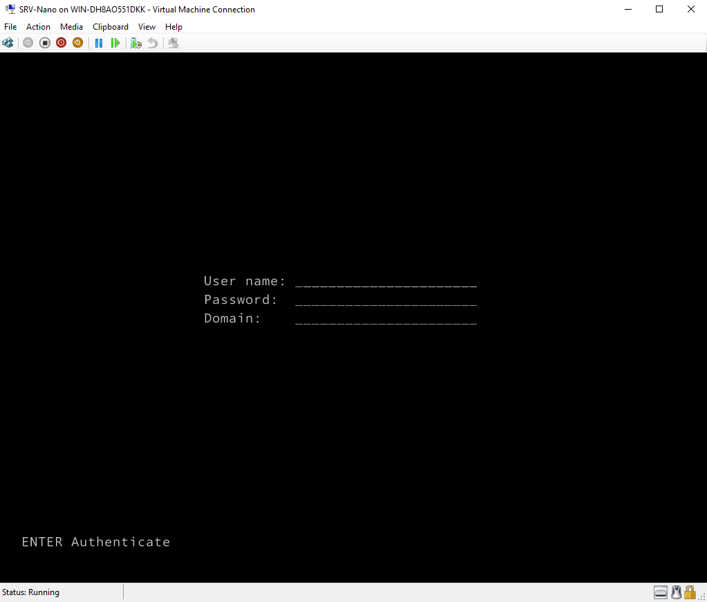
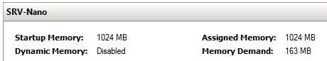
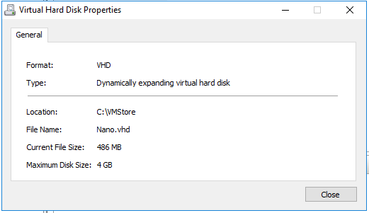
The end result…

Slide 92
Nano Server Recovery Console
Provides local access to basic configuration and network settings:
Computer name
Domain or workgroup name
Ipconfig/all information for each network adapter
Provides ability to configure local NICs and Firewall settings
How do I manage Nano Server?

Slide 93
Nano Server roles and features
Table shows roles and features that are available in this release of Nano Server, along with the Windows PowerShell options that will install the packages for them
Role or feature | Option
Hyper-V role | -Compute
Failover clustering | -Clustering
File server role and other storage components | -Storage
Windows Defender antimalware, including a default signature file | -Defender
OEM drivers—select drivers that ship in-box with Server Core | -OEMDrivers
Reverse forwarders for application compatibility, for example common application frameworks such as Ruby, Node.js, etc. | -ReverseForwarders
Hyper-V guest drivers for hosting Nano Server as a VM | -GuestDrivers
Host Support for Windows Containers | -Containers

Slide 94
Nano Server roles and features
Table shows roles and features that are available in this release of Nano Server, along with the Windows PowerShell options that will install the packages for them
Role or feature | Option
DNS Server Role | -Packages Microsoft-NanoServer-DNS-Package
Desired State Configuration (DSC) | -Packages Microsoft-NanoServer-DSC-Package
IIS Web Server | -Packages Microsoft-NanoServer-IIS-Package
System Center VMM Agent | -Packages Microsoft-Windows-Server-SCVMM-Package -Packages Microsoft-Windows-Server-SCVMM-Compute-Package
Network Perf Diagnostics Service (NPDS) | -Packages Microsoft-NanoServer-NPDS-Package
Data Center Bridging | -Packages Microsoft-NanoServer-DCB-Package

Slide 95
Remotely managing Nano Server
Remote graphical & Web tools
PowerShell remoting
VM & container management
Deployment & monitoring
Partners & frameworks
Server manager
Azure Portal tools
Task manager
Registry editor
File explorer
Server configuration
Event viewer
Disk manager
Device & driver management
Performance
Users & groups
Core PowerShell engine, language, and cmdlets
Windows Server cmdlets (network, storage, etc.)
PowerShell DSC
Remote file transfer
Remote script authoring & debugging
PowerShell Web access
Hyper-V manager
Hyper-V cmdlets
PowerShell Direct over PSRP
CimSession support
Docker
SCVMM agent & console
3rd-party agents & consoles
DISM online & VHD support
Unattended setup
Visual Studio integration
DSC Local Config Manager
Setup & boot eventing
SCOM agent
VSO App Insights
Azure Op Insights
Chef integration
.NET Core and CoreCLR
ASP.NET 5
Python, PHP, Ruby, Node.js
PowerShell Classes
PS Script Analyzer
PowerShell Gallery
PowerShellGet

Slide 96
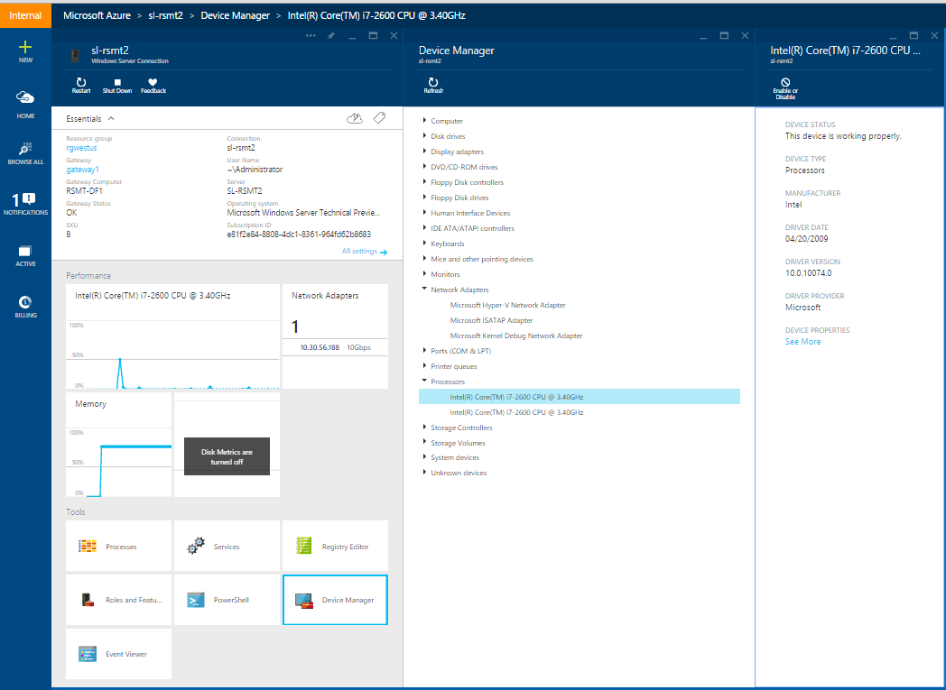
Remote Server Management Tool
Eliminating the need to ever sit in front of a server
Azure-based
Includes replacements for local-only tools
Task manager, registry editor
Event viewer, device manager
Sconfig
Control panel, file explorer
Performance monitor, disk management
Users/Groups manager
Supports Server Core and server with desktop experience

Slide 97
Security impact – In the News…
Experts: “Sony hackers were inside the company network for a long time”
“Staples breach may have affected over a million credit cards”
“Target cyber breach hits 40 million payment cards at holiday peak”
“Now at the Sands Casino: An Iranian hacker in every server”
“A cyberattack has caused confirmed physical damage for the second time ever”
“Five out of every six large companies targeted by cyber attacks in 2014”
“Home Depot confirms cyber attack from foreign entity”

